Slide 1
ENGR 216 – Spring 2019
Class 7
Universal Accounting Equation (UAE)

Slide 2
Learning Objectives
Universal Accounting Equation
Recall and express the six-term version of the Universal Accounting Equation (UAE)
Simplify the UAE for various types of systems
Conserved extensive quantity
Steady state versus unsteady
Systems with/without accumulation

Slide 3
Learning Objectives (continued)
Universal Accounting Equation
Be able to describe the following
Difference(s) between extensive quantities and intensive quantities
Difference(s) between state quantities and path quantities
Difference(s) between generation/consumption and input/output
Recall a definition of a system for UAE analysis
Describe requirements for a system boundary

Slide 4
Accounting
When we hear the term accounting, most of us immediately think of money
However, almost every engineering problem requires systematic tabulation of identifiable quantities (e.g., materials, time, money).
This is also accounting
The money part is just one example

Slide 5
Systems
A system is a subset of the universe defined by an engineer for the solution of a problem.
It is the part of the universe the engineer will model and monitor in order to evaluate some engineering process.
Universe
System
Surroundings

Slide 6
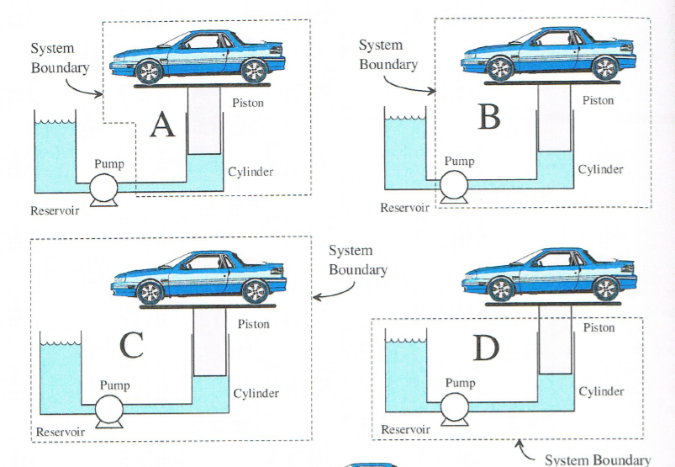
Choosing a System
You are the engineer
You have the privilege of choosing the system definition
Choice based on the problem to be solved
However, there are usually some choices that are better than others
That’s when your engineering judgment will be called into play
Holtzapple, Reece Foundations of Engineering

Slide 7
Rules for Systems
You cannot change system definition during calculations
This doesn’t mean the system quantities can’t change!
System boundaries can be any shape but must be a closed surface
System boundaries can be rigid to define a volume of space (a control volume) or flexible to define an object

Slide 8
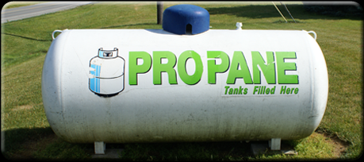
Examples:
Gas in a closed vessel
(Tanks are nice control volumes; chemical engineers love them. So does Hank Hill.)

Slide 9
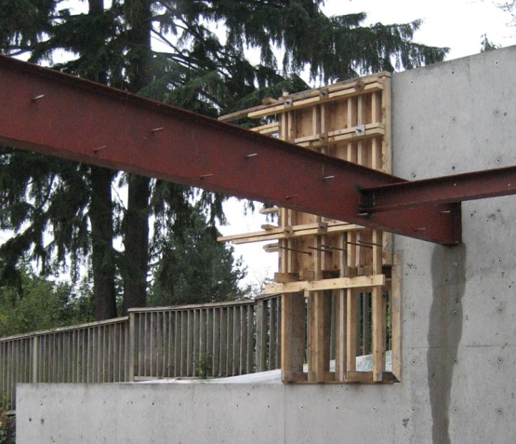
Examples:
A beam with applied loads resting on rigid supports (statics is accounting!)

Slide 10

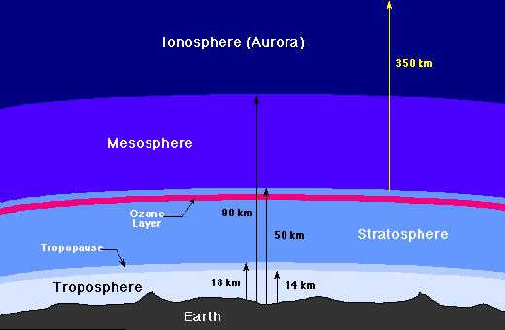
Examples:
The earth’s atmosphere
(well-defined lower boundary, hard-to-define upper boundary, interesting geometry)

Slide 11
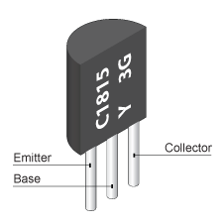
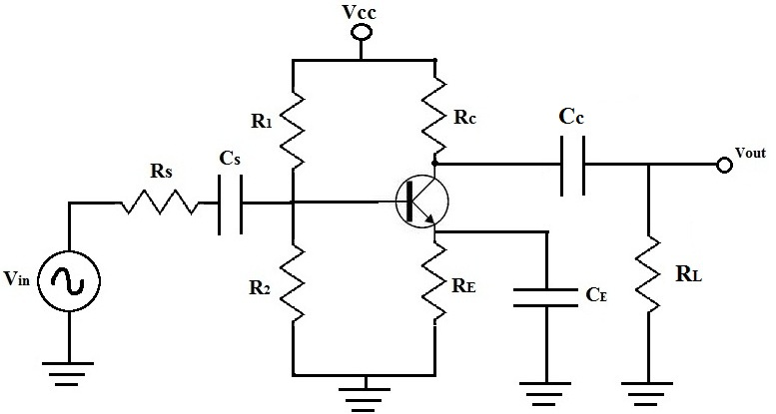
Examples:
A transistor circuit subjected to a variable currents or voltages
(Drawings of system are very important. Hard to tell what’s going on without them.)

Slide 12
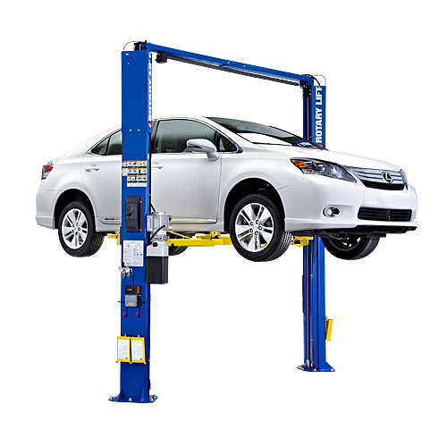
Examples:
Hydraulic lift for a vehicle
(How would you draw the system boundaries?)

Slide 13
Intensive Quantities
Intensive quantities: Quantities that do not depend upon scale*.
Examples:
Pressure
Color
Temperature
Melting Point
Boiling Point
Viscosity
*until we get to the atomic size level – then we see intensive quantities often arise from statistical mechanics

Slide 14
Extensive Quantities
Extensive quantities: Quantities that do depend upon scale.
Examples:
Mass
Moles
Area
Volume
Energy
Charge
Enthalpy

Slide 15
Derived or Composite Quantities
Derived quantities: Quantities that are combinations of Extensive Quantities.
Examples:
Density (= mass/volume)
Treat them like Intensive Quantities – i.e. densities don’t add

Slide 16
Why distinguish between intensive and extensive quantities?
Only extensive quantities can be counted.
Intensive quantities cannot be counted.

Slide 17
How to decide if a quantity is intensive or extensive.
Imagine doing something at a small scale, and then at a larger scale. When scaling up, some things will change and some will not.
Extensive: Those quantities that change
Intensive: Those quantities that do not change

Slide 18
Example
A chemist performs a reaction in the laboratory and optimizes a reaction using the following conditions:
T = 500 K
P = 300 kPa
Catalyst concentration = 50 g/L
Catalyst amount = 25 g
Reactor volume = 0.5 L
Reactant amount = 300 g
A chemical engineer is responsible for designing a plant that processes 50 tons per day of reactant. What quantities change, what quantities stay the same?

Slide 19
State and Path Quantities
State quantities are independent of the path a process takes.
Path quantities are dependent on the path taken in a process.

Slide 20
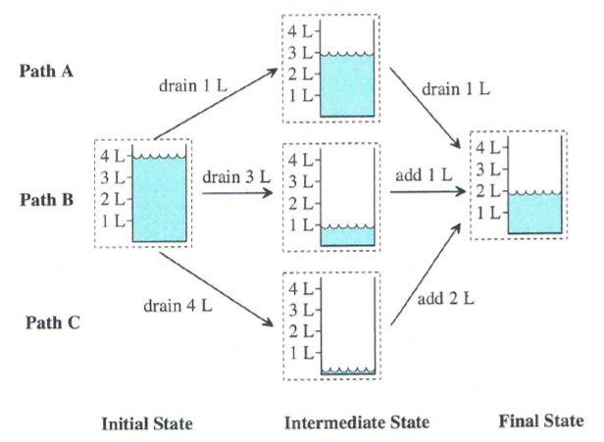
State and Path
The Initial and Final States are the same
The Intermediate States are not
Paths A, B, and C are different
Holtzapple, Reece Foundations of Engineering

Slide 21
Conservative vs. Non-conservative forces
Conservative Forces
Non-conservative Forces
Work done is independent of the path taken
Reversible
Work done is stored as a potential energy
Examples:
Gravitational force
Spring force
Magnetic and Electric forces (by some definitions)
Work done is not independent of the path taken
Irreversible
No potential energy created
Examples
Friction
Air drag

Slide 22
Pairs Exercise 1
As a pair, spend 3 minutes on the following...
Consider driving from California to New York via three different routes
One through North Dakota
One through Kansas
One through Texas
What are some path quantities?
What are some state quantities?

Slide 23
Open and Closed Systems
Closed systems: mass does not cross the boundaries of a closed system.
Open systems: mass may or may not cross boundaries in an open system.

Slide 24
Isolated and Non-Isolated Systems
These are more restrictive than open and closed
Isolated systems: neither mass nor energy nor momentum nor anything crosses the boundaries of a isolated system. (Nothing may cross.)
Non-isolated systems: one or more of these may cross boundaries in an open system. (Something may cross.)

Slide 25
Homogeneous vs. Heterogeneous Systems
Homogeneous systems: properties of the system are same throughout.
Heterogeneous systems: properties vary in space.
These definitions depend on scale – a system can be homogenous at one scale, and heterogeneous at another

Slide 26
Steady and Unsteady Systems
Steady system: system state does not change in time – does not mean there is not exchange with surroundings!.
Unsteady systems: system state changes in time in some way.

Slide 27
Why do we care about classifying systems?
It lets us know how to model a system – what math terms we need to use
It determines what physical laws are important
It lets us check that we’ve considered everything important for the system

Slide 28
Classify this system
Gas in a closed vessel
Notes:
Depends on time scale. Are we adding and removing gas? Could be steady or unsteady. Definitely not isolated. Homogeneous

Slide 29
Classify this system
A beam with applied loads resting on rigid supports
Notes:
Typically treated as isolated, steady, homogeneous

Slide 30
Classify this system
The earth’s atmosphere
Notes:
Depends on process. Closed for weather, open for atmospheric chemistry. Definitely not isolated (much heat exchange), Heterogeneous

Slide 31
Classify this system
A transistor circuit subjected to a variable currents or voltages
Notes:
Closed, but not isolated. Current flows out, supplied by power input, heterogenenous, steady

Slide 32
Classify this system
Hydraulic lift for a vehicle
Notes:
Closed. Heterogenenous, not isolated, steady.

Slide 33
Universal Accounting Equation (UAE)
The UAE is:
Final Amount - Initial Amount =
Input - Output + Generation - Consumption
System Boundary
Input
Initial
Amount
Generation
Consumption
Final
Amount
Time
Passes
Time
Passes
Output

Slide 34
Definitions
Final Amount: specifies the amount of an extensive quantity at the end of the time period.
Initial Amount: specifies the amount of an extensive quantity at the beginning of the time period.

Slide 35
Definitions
Input: specifies the amount of an extensive quantity added to the system during the time period.
Output: specifies the amount of an extensive quantity leaving the system during the time period.
Generation: specifies an amount of an extensive quantity produced in a system during a time period.
Consumption: specifies an amount of an extensive quantity destroyed in a system during a specific time period.

Slide 36
Alternate Forms
The following terms can be defined:
Accumulation = Final Amount - Initial Amount
Net Input = Input - Output
Net Generation = Generation - Consumption
Then an alternate form of the universal accounting equation becomes:
Accumulation = Net Input + Net Generation

Slide 37
Accounting Problem
Working problems with the Universal Accounting Equation requires that you clearly define:
the system (i.e., system boundaries),
the extensive quantity to be accounted,
the time period.

Slide 38
Team Exercise 1 (10 min)
Dec. 1, 2001 bank balance = $498.65
Monthly activity:
deposits = $1257.86
interest = $5.42
checks = $945.78
cash from ATM = $300.00
service charges = $8.00
What is output, input, generation, consumption and balance on Jan. 1, 2002?

Slide 39
Input or Generation? Output or Consumption?
Look beyond the system and see what happens to the quantity in the universe.
Generation/Consumption: the universal quantity changes
Input/Output: the universal quantity does not change

Slide 40
Conserved Quantities
In the universe, the amount of a conserved quantity does not change; therefore
Generation = 0
Consumption = 0
What are some conserved quantities?

Slide 41
Steady-State Systems
A steady state system is a system in which accumulation is zero; Therefore,
Final Amount = Initial Amount
Note you can have non-zero input, output, generation, and consumption. They just have to balance.

Slide 42
Team Exercise 2
Chicken Production -- A chicken coop is examined for a one-year period. The coop starts with 34,000 chickens.
During the year:
16,000 are purchased,
20,000 are sold,
12,000 are hatched,
263 die
What is the final amount of live chickens?

Slide 43
UAE for Common Systems
Steady-state systems:
By definition...
Accumulation = 0
Final Amount = Initial Amount
Therefore…
0 = Input - Output + Generation - Consumption
0 = Net Input + Net Generation

Slide 44
UAE for Common Systems
Conserved Quantities:
By definition...
Generation = 0
Consumption = 0
Net Generation = 0
Therefore...
Final Amount - Initial Amount = Input - Output
Accumulation = Net Input

Slide 45
UAE for Common Systems
Steady-state system/conserved quantities:
By definition...
Accumulation = 0
Net Generation = 0
Therefore...
Net Input = 0
Input - Output = 0
Input = Output

Slide 46
Team Exercise 3: Mixing Concrete
Concrete = Cement+Water+Gravel+Sand
Add Cement (100 kg) + Water (50 kg) +
Gravel (300 kg) + Sand (200 kg)
What is the mass of the resulting concrete?
Is mass conserved?
What losses should be accounted for?
Notes:
Discuss this; we’ll use it to talk about cons. of mass next lecture.

